Slide 1
SYSTEM ANALYSIS AND DESIGN

Slide 2
Chapter 1
Objectives;
Define system
Explain the types of systems and give examples
Understand the importance of systems
explain the different phases of system development life cycle
Enumerate the components of system analysis
Explain the components of system designing

Slide 3
INTRODUCTION
Systems are created to solve problems. One can think of the systems approach as an organized way of dealing with a problem. In this dynamic world, the subject System Analysis and Design (SAD),mainly deals with the software development activities.

Slide 4
DEFINING A SYSTEM
A collection of (related)components that work together to realize(or achieve) some objectives(or tasks) forms a system.
Regularly interacting or independent group of items working together to forma unified whole.
An organized or established procedure.

Slide 5
DEFINING A SYSTEM
The objective of most systems demands that some output is produced as a result of processing the suitable inputs.
A well-designed system also includes an additional element referred to as ‘control’ that provides a feedback to achieve desired objectives of the system.

Slide 6
DEFINING A SYSTEM
Basically there are three major components in
every system, namely;
  input,
  processing
  output.

Slide 7
COMMON TYPES OF SYSTEM
There are two main categories;
Natural Systems
Man-made Systems

Slide 8
Natural Systems
Natural systems can be divided into two sub-categories namely;
Physical systems
Living systems

Slide 9
Physical Systems
Stella systems: Consists of heavenly bodies i.e. meteors, asteroids, planets, galaxies etc.
Geological
Molecular

Slide 10
Living Systems
This has to do with everything which can be termed as being alive.
NB: Numerous research studies have proven that, giving attributes of living things to man-made systems is a sure way of creating resilient and robust systems.

Slide 11
Characteristics of Living Systems Given to Man-Made Systems
The reproducer
The boundary
The ingestor
The distributor
The converter
The producer
The matter-energy storage subsystem
The extruder
The motor

Slide 12
Characteristics of Living Systems Given to Man-Made Systems
The supporter
The input transducer
The internal transducer
The channel and net
The decoder
The associator
The memory
The decider
The encoder
The output transducer

Slide 13
Man-Made Systems
Social Systems: organizations of laws, doctrines, customs, culture etc.
An organized disciplined collection of ideas
Transportation systems: networks of highways, canals, airlines, railways etc.
Communication systems: telephones, telex etc.
Manufacturing systems: assembly lines, factories and so on.
Financial systems: inventory, general ledger, accounting and so on

Slide 14
Reasons Why Some People
Do Not Use Computers
Time
Cost
Security
Convenience
Dependence on electricity
Availability
Politics
Maintainability

Slide 15
Automated Systems
Man-made systems which interact with or are controlled by one or more computers.
NB: computers can only be assigned tasks which follow a pattern or series of patterns.

Slide 16
Common Components of Automated Systems
Computer hardware
Computer Software
People
Data
Procedures

Slide 17
Types of Automated Systems
Batch system: Sequential processing
On-line system: Accepts inputs from point of creation and returns the outputs or results to the point of creation
Real-time system: These control environments that require immediate, timely, quick processing and response which is sent to the appropriate environment
Decision support system: This helps managers and other knowledge based workers to make informed, intelligent , accurate and reliable decisions(choices)
Knowledge based system: Systems that appear to be intelligent but are just working based predefined algorithms

Slide 18
General Systems Principles
The more specialized a system is the less able it is to adapt to different circumstances
The more generalized purpose a system is the optimized it would be for particular situations
The larger a system is the more the resources required for its daily maintenance
Systems are always part of larger systems and can always be partitioned into smaller systems
Systems grow: most systems with which we are familiar do grow.

Slide 19
Participants in System Development
User
Management
Auditors, quality assurance people, and “standards bearers”
Systems analysts
System designs
Programmers
Operations personnel

Slide 20
System Development Life Cycle
System life cycle is an organizational process of developing and maintaining systems. It helps in establishing a system project plan, because it gives overall list of processes and sub-processes required for developing a system.
System development life cycle means combination of various activities.
In other words we can say that various activities put together are referred as system development life cycle.
NB: In the System Analysis and Design terminology, the system development life cycle also means software development life cycle.

Slide 21
Phases of System Development
Life Cycle
Preliminary study (Initial investigation)
Feasibility study
General Design(System analysis)
Detailed design
  System Design,
  Coding/Building/Development
  Testing
Implementation and maintenance
System Audit

Slide 22
Systems Approach
This the strategy used in the creation / development of systems.
Usually there are two main models used by professionals. Namely
  Waterfall model
  Spiral model
  These have formed the basis for a lot of new and improve models including the
  The modified waterfall model

Slide 23
Systems Approach
Waterfall Model
Waterfall model is the foundation for most of the structured development methods since the 1970’s to date. It consist of the following phases
Systems analysis
Systems design
Systems build and test
Systems introduction and transition
Maintenance of production status systems

Slide 24
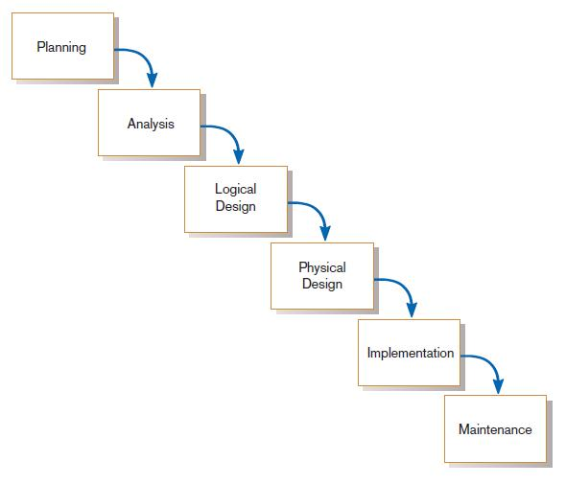
Traditional Waterfall SDLC
One phase begins when another completes, with little backtracking and looping.
FIGURE 1-10
Traditional waterfall SDLC

Slide 25
Systems Approach Spiral Model
Was introduced by Barry Boehm as approach for iterative development.
It has the same phases as the waterfall method but follows an incremental approach to system development

Slide 26
System Requirements
This is a documentation on the system and is also one of the most important activity in the system development life cycle.
This ensures the continuity of the system.
The view points of any system are:
The users requirements
The system’s requirements
Technical requirements
The user requirements: is a complete description of the system from the users point of view detailing how to use or operate the system. It also includes the major error messages likely to be encountered by the users.
The system’s requirements: contains the details of system design, programs, their coding, system flow, data dictionary, process description, etc.
The technical requirements: composes of all the technical equipment and tools needed to make the system function properly
NB: This helps to understand the system and permit changes to be made in the existing system to satisfy new user needs.

Slide 27
System’s Requirements
Suitable with general strategies
Supporting decision maker
Competitive edge
Return on investment
Overhead control
Supporting operational management
Improving information communication
Impact of information products
Ability to implement quicker and better

Slide 28
Users Requirements
Easy access:
The system: It must be solid, stable and resilient and must provide accurate information and be easy to spot mistakes in order to correct them.
Interface: It is the point of interaction between the user and the system. As such all effort should be made to make sure the user can use it.

Slide 29
Technical Requirements
Information volume
Period
Accuracy
Complexity

Slide 30
Some Popular Issues in Development
Incompatibility
Shortcomings
Low reliability
Poor resources
Bad support

Slide 31
System Survey
Survey is the process of finding out more about some subject of particular interest. This done through meticulous strategizing, planning, research and investigations to reveal what is needed(by the system).
There are two main phases;
Preliminary survey
Detailed survey

Slide 32
Phases of Survey
Preliminary survey: this is where a cursory look of the project is conducted which helps determine its feasibility
Detailed survey: an in-depth definition of what needs to be done, how it is to be done and who is to do what in order for the requirements to be achieved. It is divided into two parts namely;
  Detailing the objectives set forth
  Identifying information sources and requirements

Slide 33
Investigation Methods
Survey methods
  The interview
  Questions
  Communication
Observation methods
  Official/formal observation
  Unofficial/informal observation
Questionnaire method
  Title
  Data classification
  Data

Slide 34
Survey Report
A good survey should contain the following;
Objectives of the system
Inter-connection between related departments
Details of the current system
Future system and sketchy estimate of costs and benefits
Advice
Time frame and plan for system development
General description(non-technical)
Original document
Evaluation of the current system in terms of organizational structure, technology, information system, users’ IT skills and policy renovation

Slide 35
Survey Report
A good survey should answer the following;
Is the document of the current system adequate?
Have users reviewed and agreed with your point of view?
Has the whole report been thoroughly?
What functional requirements need further research?
Have all requirements been reviewed?
What are the substitute designing solutions?
What are the project’s possible changes?

Slide 36
WHAT YOU HAVE LEARNT
In this lesson a systematic approach to solve any given problem is explained.
Phases of system such as preliminary system study, detailed system study, system analysis, design, coding, testing, implementation and maintenance were explained.
Computer based systems were defined. System development life cycle was discussed in detail.
The different phases of the development of system are explained in detail.

Slide 37
QUESTIONS
1. Write True or False for the following statements.
(a) A collection of components that work together to realize
some objectives forms a system.
(b) System life cycle is not an organizational process of developing
and maintaining a system.
(c) In the system analysis and design terminology the system
development life cycle means software development life cycle.
(d) Coding is not a step in system development life cycle.
(e) System analysis and system design are the same phase of
system development life cycle.

Slide 38
Questions
1. Fill in the blanks.
(a) System study is the _____________ stage of system development
life cycle.
(b) Analysis involves a ____________ study of the current system.
(c) All procedures requirements must be analysed and documented
in the form of data flow diagrams, data dictionary,
___________ and miniature specifications.
(d) _____________ is a blue print of a computer system.
(e) In ___________ run the new system installed in parts.
(f) In parallel run computerized and ____________ systems are
executed in parallel.

Slide 39
TERMINAL QUESTIONS
1. Define a system. Explain the components of a system.
2. How do you explain system development life cycle?
3. Discuss the importance of system analysis and design in the
development of a system.
1.8 KEY TO INTEXT QUESTIONS
1. (A) True (b) False (c) True (d) False (e) False
2. (a) first (b) detailed (c) logical data structure
(d) structure design (e) pilot (f) manual

Slide 40
Chapter 2
Objectives;
Understanding techniques applied in information analysis
Explain DFD
Function diagram
Identify E-R diagrams
Understand Normalization and de-normalization

Slide 41
Roles of The System Analysts
Archaeologist and scribe
Innovator
Mediator
Project leader

Slide 42
Abilities of an Analyst
Skills to interview users, mediate disagreements
Ability to do more than just draw flowchart and other technical diagrams
Application knowledge to understand and appreciate user’s business
Computer skills to understand the potential uses of computer hardware and software in the user’s business
Ability to view a system from many perspectives
Ability to partition it(the system) into lower levels of subsystems
Ability to think of a system in abstract as well as physical terms

Slide 43
Popular Methods of System Analysis
Structured system analysis originated from the believe that principles of structure programming can be applied to analysis and design phase.

Slide 44
Tools supporting analysis: Data Flow Diagram, Function Diagram and Entity Relationship Diagram
Concentrate on important feature of the system,
Able to respond to changes or changes in user’s requirement with low cost and risk
Properly understand user’s environment and write documents in the same way that designers and programmers construct the system

Slide 45
Tools supporting analysis
The three(3) most important tools used in system analysis are:
Data Flow Diagram
Function Diagram and
Entity Relationship Diagram

Slide 46
Data Flow Diagram (DFD)
The Data Flow Diagram (DFD) is a graphical representation of the flow of data through an information system.
You can associate data with conceptual, logical, and physical data models and object-oriented models.

Slide 47
DFD Importance
It enables you to represent the processes in your information system from the viewpoint of data.
The DFD lets you visualize how the system operates, what the system accomplishes and how it will be implemented, when it is refined with further specification.
Data flow diagrams are used by systems analysts to design information-processing systems but also as a way to model whole organizations.
You build a DFD at the very beginning of your business process modelling in order to model the functions your system has to carry out and the interaction between those functions together with focusing on data exchanges between processes.

Slide 48
Types of DFDs
There are two types of DFDs, both of which support a top-down approach to systems analysis, whereby analysts begin by developing a general understanding of the system and gradually break components out into greater detail:
Logical data flow diagrams - are implementation-independent and describe the system, rather than how activities are accomplished.
Physical data flow diagrams - are implementation-dependent and describe the actual entities (devices, department, people, etc.) involved in the current system.
DFDs can also be grouped together to represent a sub-system of the system being analyzed.
A data flow diagram can look as follows:

Slide 49
DFD Symbols
OR
The process
The flow
The store
The internal factor
The external factor

Slide 50
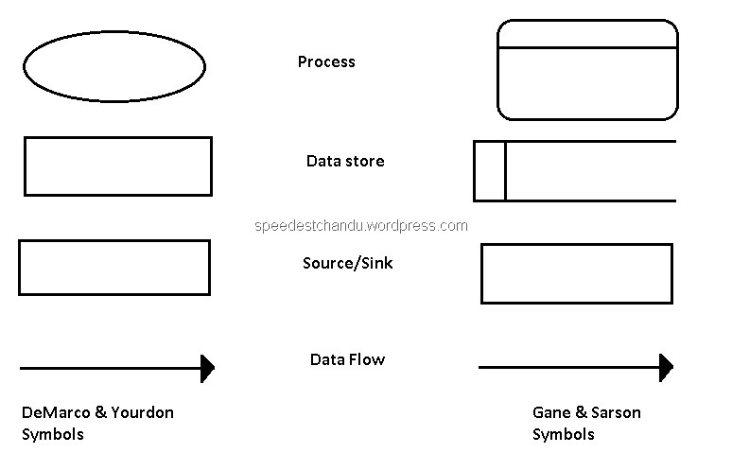
OTHER DFD Symbols

Slide 51
DFD Symbols
The process: This is used to depict the part(s) of the system which transform inputs into outputs
The flow: This is used to show the movement of information fro one part of the system to another.
The store: This is used to depict data packets at rest.
The External Factor: It is used to show anything(person, group of people or an organization) which are not internally part of the system but are connected in some way to the system. It can influence the system
The Internal Factor: It is the system’s functions or processes. These influence what happens inside the system.

Slide 52
DFD Example
2.2
Insert
New Books
Books
2.1
Classify New Documents
New Documents
Books information
Documents
Magazine information
Magazines
2.3
Insert New
Magazine
Documents Suppliers

Slide 53
Function Analysis
This is an attempt to understand what the users expect of the system regardless or how it achieves it.

Slide 54
Functional Analysis
A complete function should have the following;
Function name
Description of function
Function’s input (data)
Function’s output (data)
Events that cause changes and their efficiency

Slide 55
Function Diagram Example
Library Management
System
Readers
Management
Documents
Management
Documents
Looking up
B/R Ticket
Management
System
Reports
New Reader
Receiving
Documents
Classifying
Books
Looking up
B/R Ticket
Receiving
Document
Report
Dept_no
Checking
New Books
Inserting
Magazine
Looking up
Checking
Department
Report
New
Department
Register
New
Magazine
Inserting
Replying
Overdue
Readers
Reader
Allocating

Slide 56
Entity Relationship Diagram
An entity relationship (ER) diagram is a picturistic representation of entities and how they are connected(related).

Slide 57
Components of ERD
There are three main components of an entity model;
Entity:
  It is a subject, duty or an event about which we want to save information.
  An entity can be said to anything of importance that we want to save information about
Attribute: These are the characteristics of entities displayed by fields or columns of tables
Relationship: It is used to show the connection between system entities.

Slide 58
Components of ERD
Relationship(continued):
There are three(3) main types of relationship
One – one relationship
One to many relationship
Many – many relationship

Slide 59
Components of ERD
Attributes(continued):
Identifying: consists of one or more attributes used to uniquely identify each entity instance in the entity set
Specification: These attributes provide descriptions of the entity instance
Connection(foreign key): This points out the relationship between an entity instance in one table and another entity instance in another table

Slide 60
Models of ER Diagrams
There are two main models used to depict ER diagrams namely;
Chen notation and
Crow’s foot notation

Slide 61
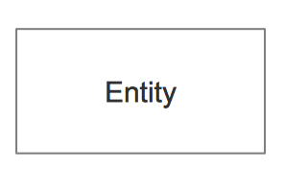
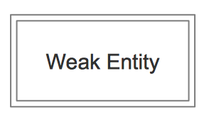
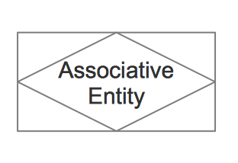
ER Diagrams Symbols
 | Entity | An entity is represented by a rectangle which contains the entity’s name.
 | Weak Entity | An entity that cannot be uniquely identified by its attributes alone. The existence of a weak entity is dependent upon another entity called the owner entity. The weak entity’s identifier is a combination of the identifier of the owner entity and the partial key of the weak entity.
 | Associative Entity | An entity used in a many-to-many relationship (represents an extra table). All relationships for the associative entity should be many

Slide 62
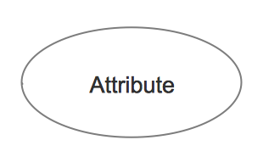
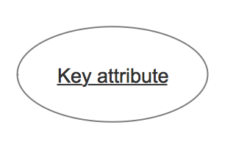
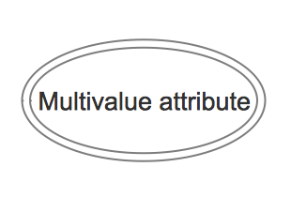
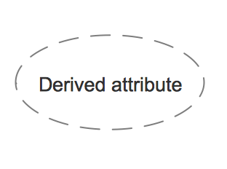
 | Attribute | In the Chen notation, each attribute is represented by an oval containing atributte’s name
 | Key attribute | An attribute that uniquely identifies a particular entity. The name of a key attribute is underscored.
 | Multivalued attribute | An attribute that can have many values (there are many distinct values entered for it in the same column of the table). Multivalued attribute is depicted by a dual oval.
 | Derived attribute | An attribute whose value is calculated (derived) from other attributes. The derived attribute may or may not be physically stored in the database. In the Chen notation, this attribute is represented by dashed oval.

Slide 63
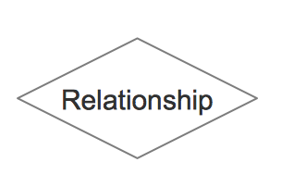
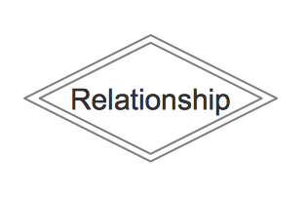
 | Strong relationship | A relationship where entity is existence-independent of other entities, and PK of Child doesn’t contain PK component of Parent Entity. A strong relationship is represented by a single rhombus
 | Weak (identifying) relationship | A relationship where Child entity is existence-dependent on parent, and PK of Child Entity contains PK component of Parent Entity. This relationship is represented by a double rhombus.

Slide 64
ERD Models Example
CHEN NOTATION
Student_ID
Course_ID
Course_Desc
LastName
Sex
takes
Student
Course
Course_ID
Course_Name
Age
Course_Duration
FirstName

Slide 65
ERD Models Example
CROW’S FOOT NOTATION
Student
Student_ID
FirstName
LastName
Age
Sex
Course_ID
Course
Course_ID
Course_Name
Course_Desc
Course_Duration

Slide 66
Data Model Development
There are two(2) main steps;
Defining entities: The following would help you define which entities require storing details about
  Information relating to one of the objects of the system(e.g. borrowing list, returning lists)
  Information relating to major assets or resources used in the system(such as book store)
  Information about planning and controlling(such as book returning deadline, financial plan)
Defining relationships: After identifying entities find the connect between them

Slide 67
The Advanced Data Modeling
Sometimes there are complicated contexts in realities where analyst must display them well
Below are some of those contexts;
Optional relationship
Abstract entity
Recursive relationship

Slide 68
Normalization
Normalization is the process of analyzing attributes in an entity set(table/relation) in order to minimize repetition, avoid redundancy and eliminate ambiguity from entity sets

Slide 69
Normalization
First Normal Form(1NF): A relation is said to be in 1NF if and only if it contains no repeating groups
Second Normal Form(2NF): A relation is said to be in 2NF if and only if it is in 1NF and every non key attribute(composite key) is dependant on all parts of the key.
Third Normal Form(3NF): A relation is said to be in 3NF if and only if it is in 2NF and non key attribute is functionally dependant on another non key attribute
NB: For this course we only considered the first three normal forms

Slide 70
De-Normalization
On some occasions, after the normalization process, there is the need to reverse it. This process of reversing or undoing normalization is termed de-normalization.

Slide 71
Completion of Information Analysis
Finally we have to do the following;
Corporation of new requirements
Supporting tools and techniques
Summary of analysis process

Slide 72
Summary
We learnt;
Which techniques are applied in information analysis
How to explain DFD
How to create a function diagram
How to identify E-R diagrams
The types of E-R models
How to Normalize and de-normalize

Slide 73
Chapter 3
SYSTEM DESIGN

Slide 74
Chapter 3
Objectives;
Learn the meaning of system design
The techniques used in system’s design.
Understand what is meant by user interface
Identify the different kinds of user interfaces
Identify the ideal interface for users of the system

Slide 75
The Designing Specifications
System design is the process of refining the deliverables from system’s analysis phase into a form programmers can understand.
In principle System analysis is different from system design

Slide 76
Principles of Structured Design
Structured design is the result of a desire on the part of its authors to formalise what they consider to be good programming practice
Structured design should be geared towards addressing changes that occur in response to shifts in the competitive environment
Functionality is essential throughout the structured design process

Slide 77
Challenges Software Engineers Face in Structured Design
The suppressing of coding issues, making these issues subservient to design principles
Acceptance of system view and not the local view as key indicator of success or failure
Resolution of issues related to ‘finishing’ the design through application of predetermined value systems.

Slide 78
Guidelines For Introducing
Structured Design
Make it clear from the start that Structured design is not a remedy for any problems of the organization
Obtain support from anyone who may be affected by this change
Emphasize the flexibility that structured design provides and downplay the misconception that it is restrictive
Structured design development passes through two primary phases: Logical Design development and Physical Design development

Slide 79
Guidelines For Introducing
Structured Design
Logical Design transforms the dataflow diagrams developed during the structured analysis phase into refining the design to reflect the kinds of quality attributes that structured design encourages
Physical Design phase involves the modification of the Logical design to accommodate whatever changes necessary

Slide 80
Stages of Design as a Process
Transformation of the problem model into an initial solution model
Embellishment of initial design to include necessary features
Transformation of the structured English into pseudo code.
Evaluation and refinement of the qualities of the design
Revise the design to accommodate implementation constraints

Slide 81
Design Goals and Objectives
The design objectives of the user implementation model are the quality of the design.
The efficiency and accuracy of the system is directly related to the nature of the design as created by the designer.
The most important guidelines are coupling and cohesion;
Cohesion: It is the degree to which the components of a model are necessary and sufficient to carry out one single well defined function.
Coupling: It is the degree to which modules are interconnected with or related to one another.

Slide 82
Relationship Between System
Analysis and Design
Some failings of structured analysis and their corresponding symptoms during design
Problem | Effect on Design
Dataflow diagram not balanced | Interface Problems
‘Fuzzy’ process name | Need for repartitioning
No dictionary | Duplicates and aliasing
Dictionary not correlated with dataflow diagrams | Duplicates and aliasing and interface problems
Dataflow diagrams not correlated with dictionary | Duplicates and aliasing and interface problems
Pseudocode not validated | Logic errors
Pseudocode not correlated with dictionary | Data aliases, interface prolems

Slide 83
 | Development phase
Type of Model | Structured Analysis | Structured Design | Implementation
Process | Data Flow Diagrams Dictionary Pseudocode | Structure Chart Dictionary Pseudocode | Code Dictionary
Information | Entity-Relationship Diagram Dictionary | Database Design Dictionary | Implemented Database Dictionary
Event | Event Model Dictionary | Event Model Dictionary | Queuing Model Dictionary

Slide 84
Principles of Procedure Design
A well defined procedure is clear, unambiguous, complete and concise.
Procedures should cover every enventuality
All steps of a given procedure should assume the same base level of knowledge or experience on the part of user
When procedures require actions by two or more persons, the boundary should be well defined
When designing procedures, analysts should ask themselves if a given task requires human processing

Slide 85
Other Principles of Procedure Design
Standardize procedures whenever possible
Be sure new procedures are compatible with existing procedures and not conflicting or counterproductive
Guard against procedures that will evoke resistance or negative reactions from employees
Avoid assigning a single individual responsibility for two procedures that similar yet different.
Allow for feedback and evaluation

Slide 86
The Stages of Design
It is basically similar to the way the system analyst develops models in the system analysis phase
There are two main models for design namely:
Systems implementation model
Program Implementation model

Slide 87
Systems Implementation Model
Systems implementation model can be divided into two:
Processor model
Task model

Slide 88
Processor Model
Processor model: At this level, the system’s designer decides how the essential model should be allocated to different processors and how those processors should communicate with one another

Slide 89
Processor Model : Issues During Design
Cost: economical solution
Efficiency: ability to meet performance requirements
Security: security requirements/ concerns of the end user
Reliability: ability to meet the minimum requirements
Political and operational constraints

Slide 90
Task model
Task model: When the processes and stores are have been allocated to processors, the system’s designer assign processes and data stores to individual purpose tasks.

Slide 91
Program Implementation model
It is the model used to depict how the processors are going to handle the tasks and in which order.

Slide 92
Tools and Techniques of Design
As with any other profession, in other to create good designs the system designers need to have some skills(techniques) and tools to aide them.

Slide 93
Choosing The Right Tool
For The Right Task
Consider the following:
Will it help the team arrive at an understanding of the system under development
Is it easy to learn? Easy to use?
Will it serve user-analyst communication
What does it cost?
What data structures does it use?
What data flow and control features does it have?
Is the technique manageable?

Slide 94
Some Tools For System Design
Information System Design and Optimization System (ISDOS): it Is focused towards generating system specifications from user requirements recorded in a machine –readable form, design an optimal system to meet these specifications , and construct code for operational system.
Steps in ISDOS:
  Definition of information problem in problem statement language(PSL)
  Problem statement analyser ( PSA) analyses input in PSL
  A coded statement of the problem is then sent to system optimization and design algorithm(SODA) for processing and output

Slide 95
Some Tools For System Design
  The output is directed to two ISDOS modules Data Re-organizer who constructs files, storing data on selected device in the form specified, and the code generator, which organises the problem statements into programs.
  Finally, a module called System Director produces the target information processing system, using the generated code, the stored data and the timing specifications as determined by the physical design algorithm

Slide 96
Some Tools For System Design
Pseudo code: It is a tool used in writing program logics(algorithms) which can be developed into computer program. It is not an actual programming language
Structured Design(SD): It is the method of decomposing large systems into small manageable independent modules which can modified without much effect on other modules.

Slide 97
Some Tools For System Design
Jackson Design Methodology(JDM): It is a three step design technique.
  First problem logic is structured
  Next the analyst structures program logic based on the data structures
  Finally, the analyst defines the tasks to be performed in terms of elementary operations and assigns operations to suitable components of the program structure

Slide 98
Some Techniques For System Design
Hierarchy Plus Input Process and Output (HIPO) : It is a graphic technique used to describe a system.
Structured Analysis And Design Technique(SADT): It is a technique employed when developing large systems. A precise notation is used to communicate analysis and design results
Entity Relationship Model(E-R Model): It is used in database design to help describe how entities in an enterprise are related to one another

Slide 99
Some Techniques For System Design
Data Structure Diagram(DSD): It is used to pictorially represent data relationship that is relationship amongst the records.
CASE*Method: It is a structured development technique used by ORACLE consultants, and design is one of its stages.
  Analysis
  Design
  Build and User Documentation
  Transition
  Production

Slide 100
The Phases Of Design
From our earlier lessons we can agree there are design tools and techniques. We can also say with certainty that a good design directly influences the effectiveness of the system developed.
It is recommended that the percentage distribution between anlysis, design and implementation is 50%-60% for analysis and design phases and 40%-50% for implemntation phase

Slide 101
The Phases Of Design
The three primary stages of design are:
  Initiation: The first stage of design usually incomplete
  Abstraction: Derived fro initiation results and involves completion of the design. Apply coupling and cohesion
  Instantiation: Based on abstract design and involves refining and revising the design to make use of specialised operating system features.

Slide 102
Stages Of Instantiation
The stages are organised into two main phases:
Logical Design: This phase is focussed on the development of a design which is directed by an abstract machine and operating environment.
Physical Design: This is the creation of the blueprint of the system

Slide 103
User Interface
An interface is the point of interaction (connection) between a user and a system.
There are many kinds of interfaces some include:
Character User Interfaces
Command Line User Interfaces
Graphic User Interfaces
Direct Mind/ Brain User interfaces
Direct Manipulation User interfaces
Zooming User Interfaces
Audio User Interfaces
Touch User interfaces etc.
NB: In choosing the ideal interface always consider the users you are a targeting.

Slide 104
System Monitoring Design
In order to ensure the system is reliable, efficient and safe it must be monitored regularly
Things to consider:
  Accuracy
  Safety
  Privacy

Slide 105
Summary
We learnt;
What structured design is
Some challenges developers face in design
How to choose the tool or technique
Some tools and techniques in design
Some types of user interface

